Slide 1

Technical Event Generator web Portal for Students
Submitted by: -- Mannu Kumar 12204749

Slide 2
Introduction
The "Technical Events Generation Web Portal for Students" is an innovative platform designed to cater to the specific needs of students interested in technical events and activities.
The main purpose of this project is to simplify the process of handling each event by providing a web interface for admin, teacher, and students. In this the admin creates a technical event for the users (both student and teacher). At the time of login page, on this page one option is sign up. In sign up, the user fills the basic information like, name, phone number, password…and so on. After signing up, user directly go to the sign in page. In sign in page, the user enters two information, first is contact number and second is password. In the user module, the user easily registered the event.

Slide 3

Scope of Project
The scope of this project is to easily conduct the event. The event is related to technical field. i.e., quiz of programming language, bootcamp of any field and so on. The registered user is easily accessing the event. If once the date expire, no one can register in that event.
Event Listings: Display a comprehensive catalog of technical events. Sort events by type (e.g., workshops, hackathons, seminars), date, and location. Implement a search functionality for users to find events of interest.
Event Creation: Allow registered users (students and faculty) to create and publish new events. Gather event details, including titles, descriptions, dates, times, venues, and organizers.
Registration and Ticketing: Enable users to register for events directly through the portal. Support secure payment processing for events with registration fees.

Slide 4
Modules
There are two modules in this project, these are: --
1. Admin
2. User
In user module, there are two types of user: --
1. Teacher
2. Students

Slide 5

Functionalities of Admin Module
In admin module, the admin is just as administrator. The functionalities of this module are to create an event, add the student, add the teacher and view the registered user records. At the time of creation of event, the details ask in the starting and ending date of the event. If the passing date is coming, then the event is automatically active in status. By default, it is inactive. Once the status is active then this event is visible on the user interface.

Slide 6

Functionalities of User Module
The user module started from the login interface. That required the contact number of user and password which is entered at the time of registration. Once the user is legginged successfully then the user interface is open. In this interface, only active events are visible which is added student. The work of user is only to register candidates by clicking the registration button. If any added candidates are not wanted to be registered in particular event, then the user not registered that candidates in this event. It means, the user having only functionality to registered and deregistered candidates

Slide 7
Tools and Technology
Technology: --
In front end design, the technology used these are: --
1. HTML, CSS, JS
2. Bootstrap
In back-end design, the technology used these are: -- 1. PHP: -- As the connection of database and design the user friendly.
2. MySQL: -- As the database purpose
Tools: --
The coding part is done by the VSCode.

Slide 8
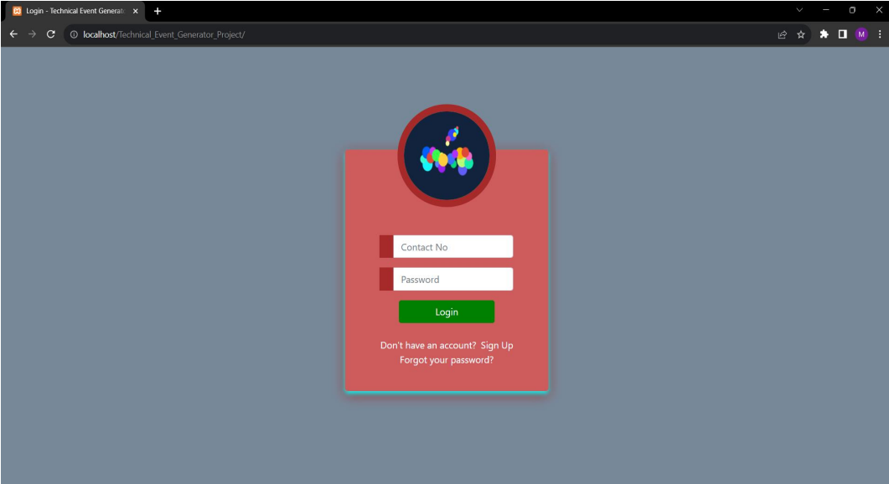
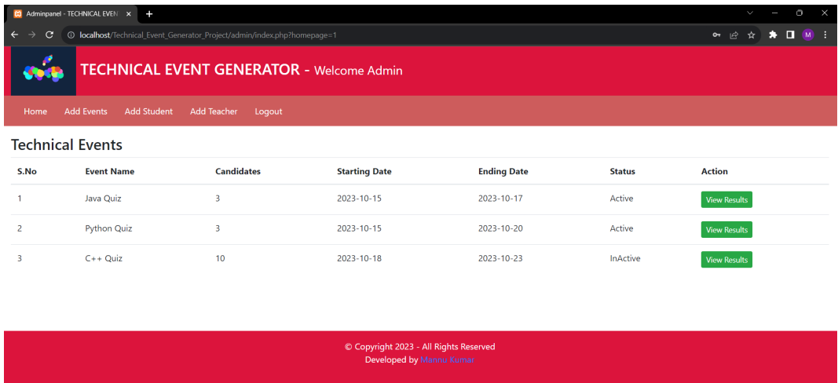
Screenshots

Slide 9
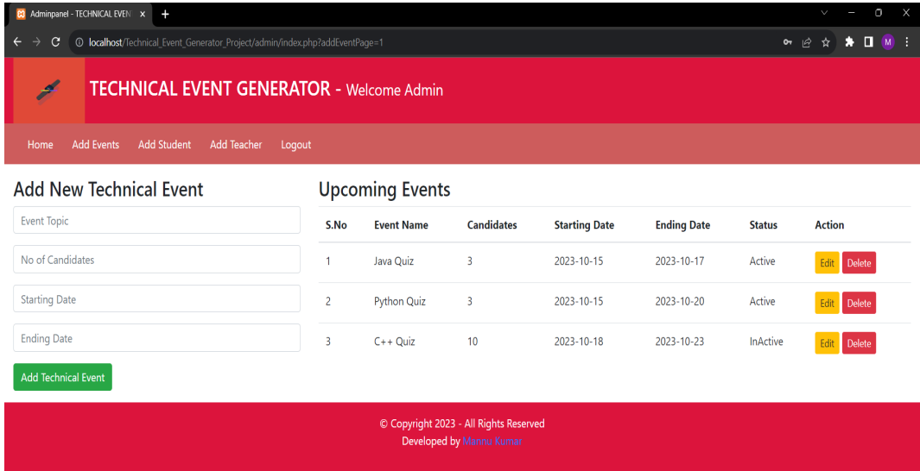
Screenshots

Slide 10
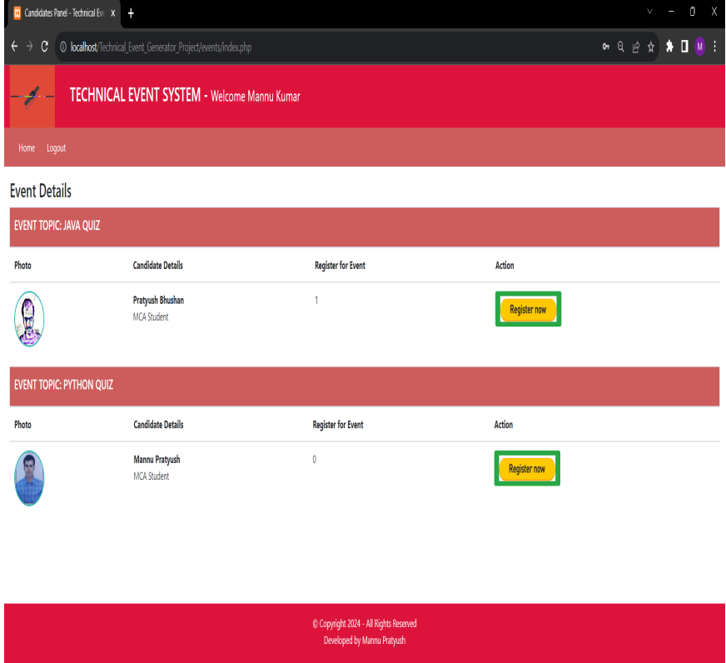
Screenshots

Slide 11

Thank You!!

